Slide 1
Using Generative AI to Aid in the Description of Historic Postcards
Mike Ellis MLIS, BSc, BA
Digital Literacy and Virtual Services Librarian
Winnipeg Public Library
email: mellis@winnipeg.ca

Slide 2
PastForward WPL’s Digital Repository
Began in 2012
Preserving materials of historical value
Public access to Winnipeg and Manitoba History
pastforward.winnipeg.ca

Slide 3
The Rob McInnes Collection
Began in 2012 as PastForward’s first collection
2000 early 20th Century Winnipeg postcards
Scanning & cataloguing contracted out
Descriptive quality issues  brought in-house
Notes:
Local Winnipeg collector. Does talks around the city. Including here at MLC a few years back in 2017?

Slide 4
A Rookie Mistake
2013: High descriptive standard set
Transcribe title or create one
Create a description of the photo, often requires research
Street view link
Photographer
Sender
Recipient
Recipient address
Portrait subject
Annotations
Transcribe message
Notes from the developer
Postal data: stamps, postmarks (sending P.O. & date, receiving P.O. & date, Special cancellation stamps)
Publisher
Printer & Printer location
Series number
Serial number
Year of creation
Date mailed
Physical description
Identifier
Language
Historical names
Signs and banners
Subject geography, address, and latitude and longitude
Notes:
Say: This is an actual picture of me before this experience when I was a newly minted librarian.
Description: say, “Not just, ‘a building with a clock on the side of a road.’”

Slide 5
Scope Creep
2014: McInnes more than doubled donation, now 5,000+ postcards
2015: Martin Berman donation of another 5,000+ postcards
WPL scanned his collection and the City of Winnipeg Archives houses them for physical access

Slide 6
Reprieve
2016: Hired 0.7FTE trained and experienced cataloguer
1200 cards published per year (And there was much rejoicing)
Image source: Monty Python and the Holy Grail
Notes:
Say: Note that the cataloguer had other duties as well, including scanning cards.

Slide 7
Reprieve
Temporary
2023: Lost 0.7FTE trained and experienced cataloguer (Run away!)
Image source: Monty Python and the Holy Grail Image upscale: ChatGPT Arthur excitement boost: ChatGPT (unrequested)

Slide 8
Tech to the Rescue?
Scanning and ingestion had already been automated early on
Industry standard OCR (ABBYY, etc.) was too error-prone on type and useless on handwriting
Early AI misfires…

Slide 9
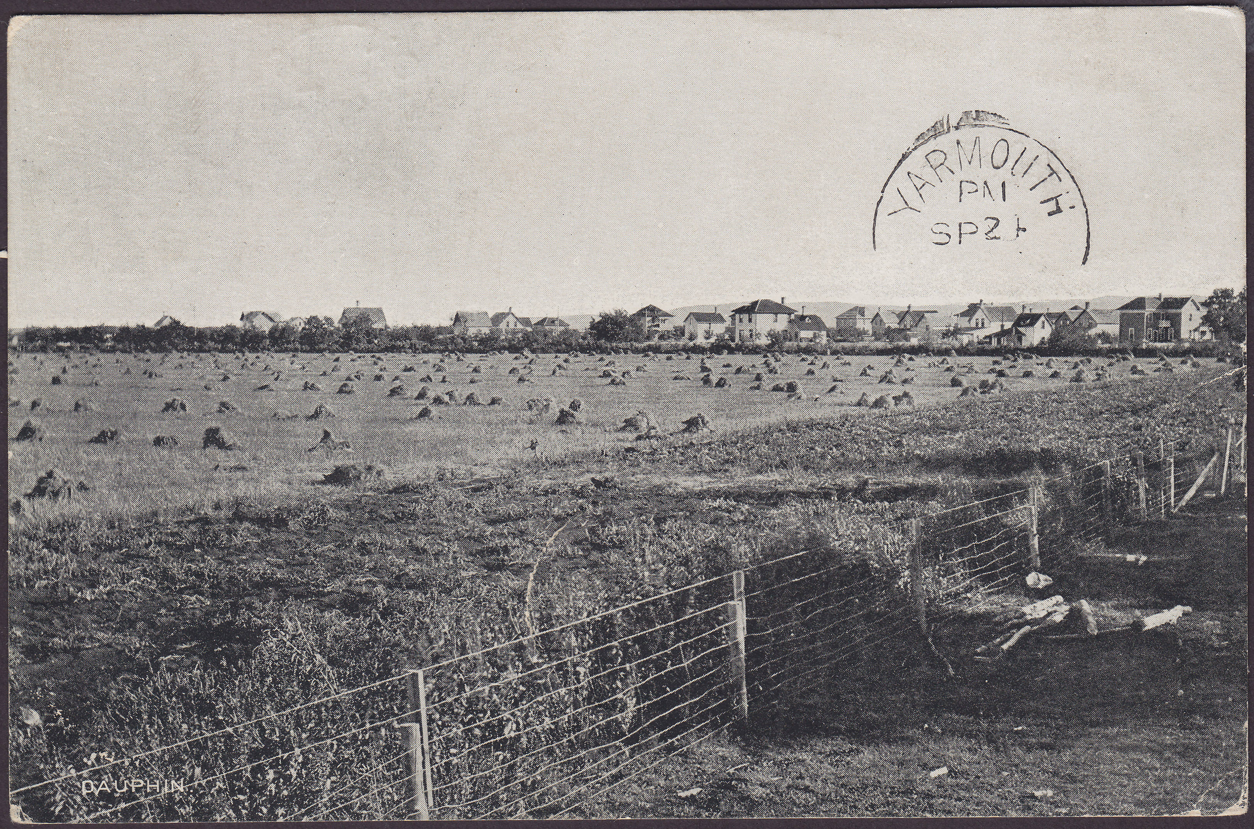
Experiments Pre-2016
AI description: “A toboggan” *
* recreation

Slide 10
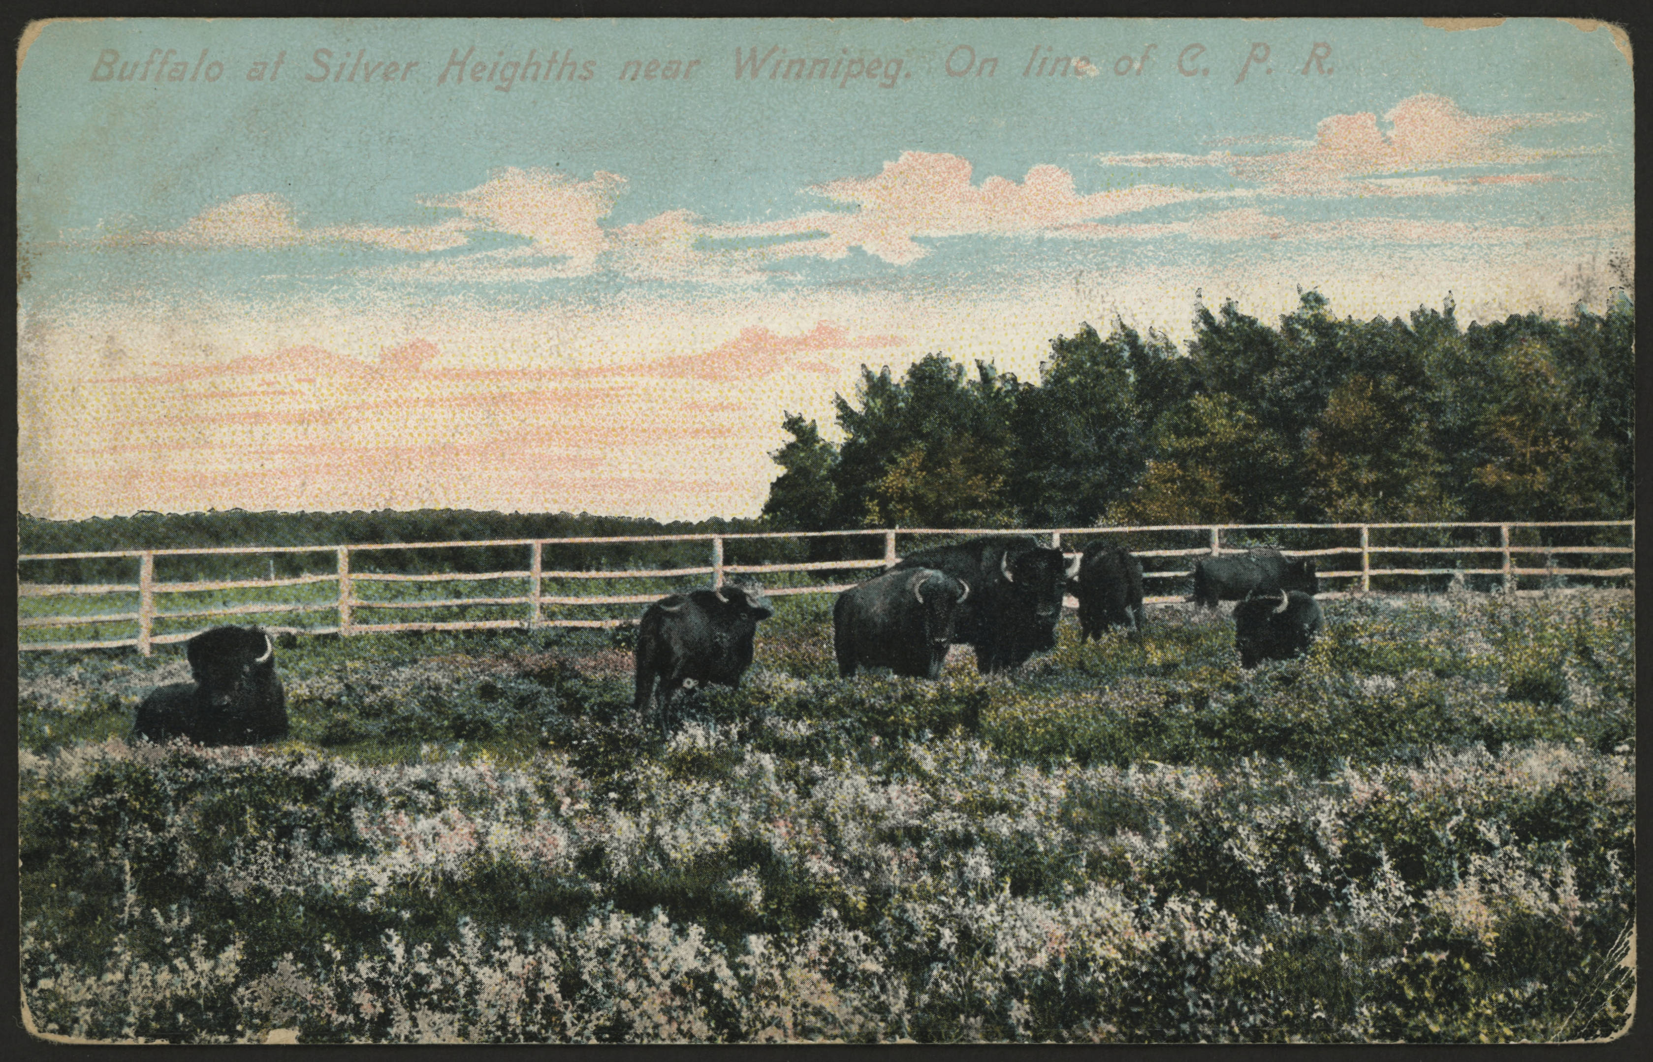
Experiments Pre-2016
AI description: “A toboggan” *
* recreation

Slide 11
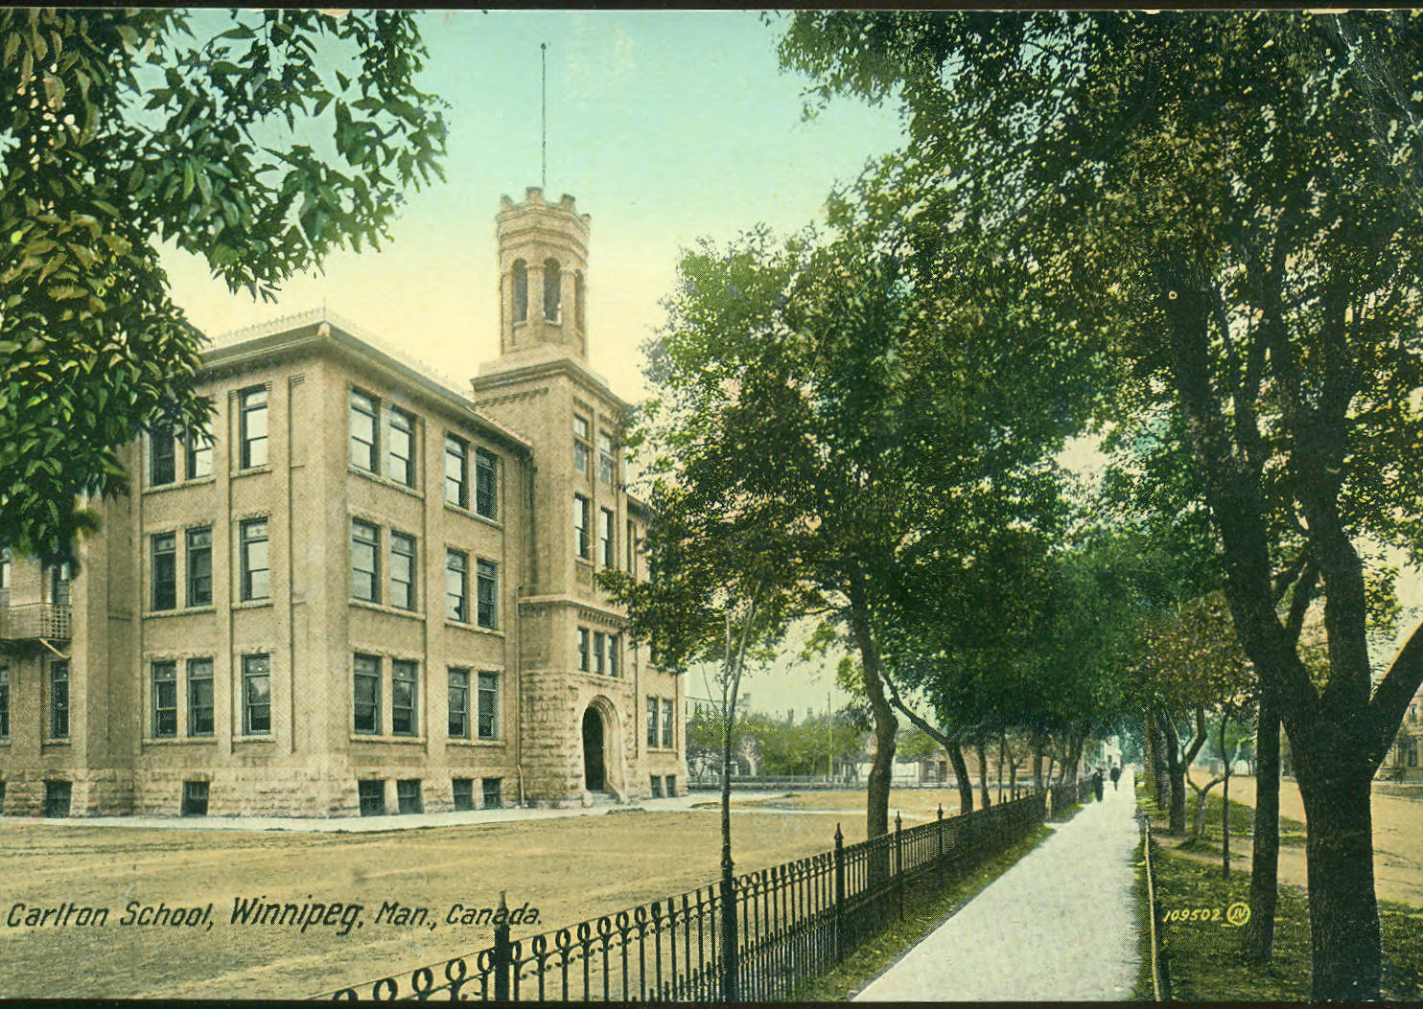
Experiments Pre-2016
AI description: “A toboggan” *
* recreation

Slide 12
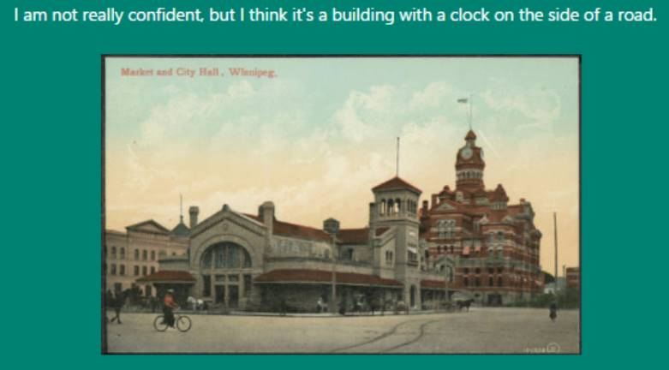
2016 Microsoft’s Machine Vision API
Early signs of usefulness
However, lack of depth or sophistication

Slide 13
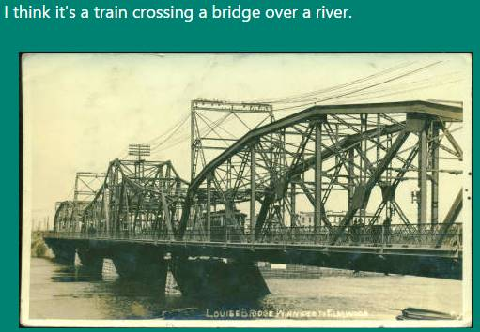
2016 Microsoft’s Machine Vision API
Early signs of usefulness
However, lack of depth or sophistication

Slide 14
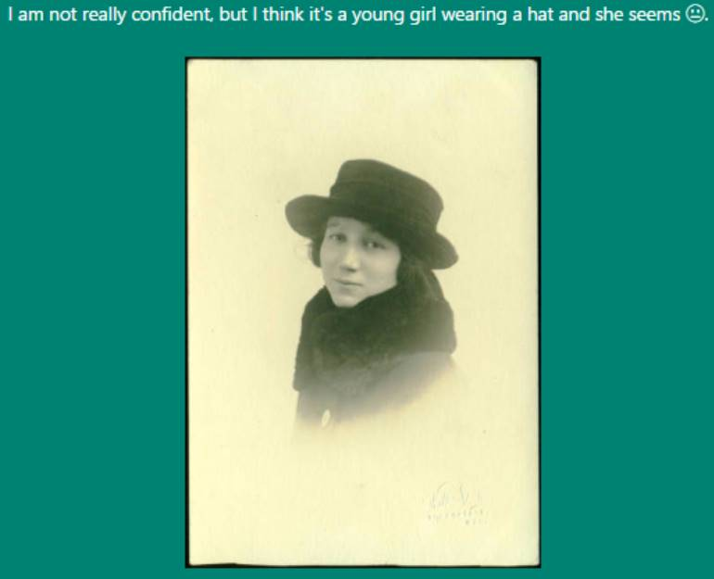
2016 Microsoft’s Machine Vision API
Early signs of usefulness
However, lack of depth or sophistication

Slide 15
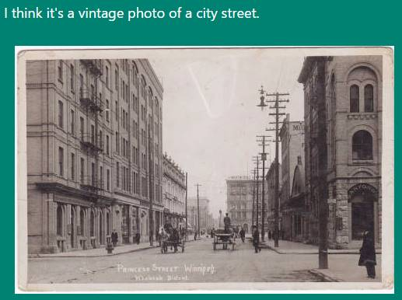
2016 Microsoft’s Machine Vision API
Early signs of usefulness
However, lack of depth or sophistication

Slide 16
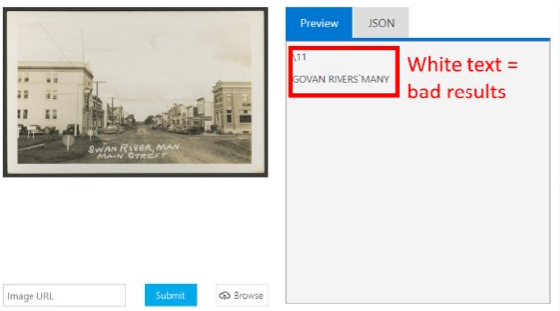
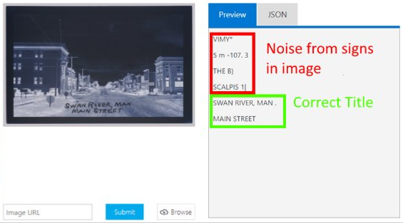
2016 Microsoft’s Machine Vision API
Image to text worked on hand-printing… if the text was black.
Wrote script to send cards to Microsoft and pre-fill title for cataloguer
Cataloguer reported correcting errors took more time than manual transcription

Slide 17
GPT-4 Breakthrough
2023: GPT-4 introduced
Testing  reasonably accurate, useful results
Built automated description workflow

Slide 18
How To
Create OpenAI developer account (not free)
Write script to send each card image to OpenAI
Specify account key
Specify GPT version to use
Specify prompt *
Receive, convert, and save response.

Slide 19
Prompt “Engineering”
The prompt is never finished (probably)
Every additional request is another opportunity to discover a new problem

Slide 20
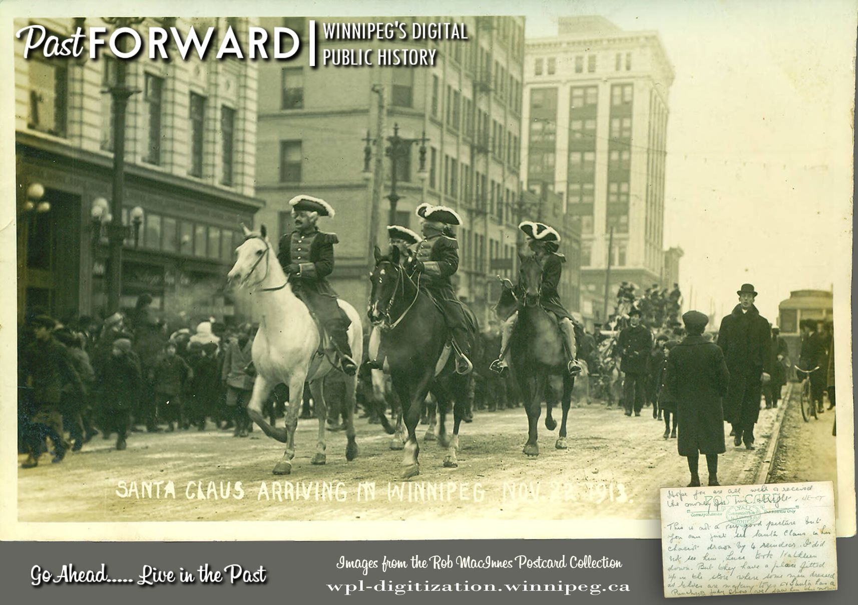
Prompt (as of late 2024)
Attached is an image showing the front (left) and back (right) sides of an historic postcard. DESCRIBE USING ALL OF THE FOLLOWING (BUT LEAVE BLANK IF NOT KNOWN, **do not put in placeholders like unknown, not applicable, none identified). Use contextual clues like automobiles and clothing styles to help estimate date of creation. respond formatted as JSON. Much of the information is available at http://pastforward.winnipeg.ca including descriptions of cards with the same photos on them. You can use these when describing the subject of the photo, its location, etc.; but not title, serial number, or information from the back of the postcard, or especially not the identifier. Do not leave any fields out, especially identifier.
Complete: Yes Title: Either OCRed text from the front (without square brackets) or a short description you write (placed in square brackets). Do not put OCRed text in square brackets. Description: Your description of the image on the front card. Do not use flowery prose like, "It provides a glimpse into early 20th-century farming techniques." Do not use information from the title to augment your description. The description should only contain information that can be verified from the content of the image. Street View: leave blank Photographer: The photographer, if possible. Photography Studio: The photography studio, if possible. Sender: If the card was sent by someone, then this is their name. Recipient: If the card was sent to someone, then this is the recipient's name. Recipient Address: If the card was sent to someone, then their address. Portrait Subject: If the picture on the front is of a person, their name. Annotation: Additional notes or annotations on the card, after the card's main use (by collectors, etc.) Message: Transcription of any message written on the card. Do not try to preserve layout, particularly do not use \\n. Postal Data: Postmarks, postage stamps, and cancellation stamps. The lowest digits on a postmarks are typically the year either four digit or two. E.g., "Postmarks: CITY PROV. MMDD YY (or YYYY); Postage: [describe stamp]; [mention special advertising stamps]“ Publisher: The publisher of the postcard. Publisher Location: Location of the publisher. Printer Location: Location of the printer. Serial Number: Serial number, if applicable. Date Mailed: Date the postcard was mailed. Use YYYY-MM-DD format. Do not use the square brackets here. This should be learned from the postmark, not a handwritten date in the message section. Physical Description: Physical description of the postcard. Estimate dimensions of the postcard based on 600dpi scan, give results in mm. Do not mention that it is based on the scan resolution. Identifier: {IDENTIFIER} Language: Language of the written message on the postcard. Historical Names: Historical names (famous people, former names of buildings or places, etc.) associated with the postcard. Signs and Banners: Descriptions of signs and banners in the image. Titles of the postcard are not included. Sign must be part of photo. Do all that you can recognize. Signs cannot be on the back of the card. Subject: Subjects of the photo using TGM controlled vocabulary, semicolon separated, with first letter of the first word in each subject capitalized. Note that ampersands are used instead the full word "and", the term is "Churches" not "Church buildings", and that there is no term "Streetcars" rather one uses "Street railroads" similarly, it isn't "Railway cars" but rather "Railroad cars". "Stairways" is used while "Staircases" is not. "Bands" is used, "Bands (Music)" is not. "Comic books" is used, "Comic books & strips" is not. Note that related terms are often combined, it's not "City halls" but it is "City & town halls", if you have the functionality to verify that the entries are actually TGM terms then do so. Geography: Geographic coverage of the postcard like "Downtown, Winnipeg" or "Exchange District, Winnipeg". This is only for when there are photos or illustrations of actual places. It is not enough for a card to be titled, "Winnipeg," for it to get an entry here. Subject Address: Address of the subject like 123 Main Street, Winnipeg, Manitoba, Canada, H0H 0H0. This is only for when there are photos or illustrations of actual places. It is not enough for a card to be titled, "Winnipeg," for it to get an entry here. Geographic Coordinates: latitude and longitude of the subject. This is only for when there are photos or illustrations of actual places. It is not enough for a card to be titled, "Winnipeg," for it to get an entry here. Date Range: The earliest the photo could have been taken to the latest. Use postal information (must be younger than any dates stamped or written on card), clothing and automobile styles, and the presence of a building or combination of buildings. All Search Years: A semicolon-separated list of all years in the date range. E.g., 1901-1903 becomes 1901; 1902; 1903 Type: Still image Format: Postcard Collector: Martin Berman Usage Statement: Public domain Digital Publisher: Winnipeg Public Library Binder: {BINDER} Type: Still image Format: Postcard Collector: Martin Berman Usage statement: Public domain Digital Publisher: Winnipeg Public Library

Slide 21
Required corrections in red
Attached is an image showing the front (left) and back (right) sides of an historic postcard. DESCRIBE USING ALL OF THE FOLLOWING (BUT LEAVE BLANK IF NOT KNOWN, **do not put in placeholders like unknown, not applicable, none identified). Use contextual clues like automobiles and clothing styles to help estimate date of creation. Respond formatted as JSON. Much of the information is available at http://pastforward.winnipeg.ca including descriptions of cards with the same photos on them. You can use these when describing the subject of the photo, its location, etc.; but not title, serial number, or information from the back of the postcard, or especially not the identifier. Do not leave any fields out, especially identifier.
Complete: Yes Title: Either OCRed text from the front (without square brackets) or a short description you write (placed in square brackets). Do not put OCRed text in square brackets. Description: Your description of the image on the front card. Do not use flowery prose like, "It provides a glimpse into early 20th-century farming techniques." Do not use information from the title to augment your description. The description should only contain information that can be verified from the content of the image. Street View: leave blank Photographer: The photographer, if possible. Photography Studio: The photography studio, if possible. Sender: If the card was sent by someone, then this is their name. Recipient: If the card was sent to someone, then this is the recipient's name. Recipient Address: If the card was sent to someone, then their address. Portrait Subject: If the picture on the front is of a person, their name. Annotation: Additional notes or annotations on the card, after the card's main use (by collectors, etc.) Message: Transcription of any message written on the card. Do not try to preserve layout, particularly do not use \n. Postal Data: Postmarks, postage stamps, and cancellation stamps. The lowest digits on a postmarks are typically the year either four digit or two. E.g., "Postmarks: CITY PROV. MMDD YY (or YYYY); Postage: [describe stamp]; [mention special advertising stamps]“ Publisher: The publisher of the postcard. Publisher Location: Location of the publisher. Printer Location: Location of the printer. Serial Number: Serial number, if applicable. Date Mailed: Date the postcard was mailed. Use YYYY-MM-DD format. Do not use the square brackets here. This should be learned from the postmark, not a handwritten date in the message section. Physical Description: Physical description of the postcard. Estimate dimensions of the postcard based on 600dpi scan, give results in mm. Do not mention that it is based on the scan resolution. Identifier: {IDENTIFIER} Language: Language of the written message on the postcard. Historical Names: Historical names (famous people, former names of buildings or places, etc.) associated with the postcard. Signs and Banners: Descriptions of signs and banners in the image. Titles of the postcard are not included. Sign must be part of photo. Do all that you can recognize. Signs cannot be on the back of the card. Subject: Subjects of the photo using TGM controlled vocabulary, semicolon separated, with first letter of the first word in each subject capitalized. Note that ampersands are used instead the full word "and", the term is "Churches" not "Church buildings", and that there is no term "Streetcars" rather one uses "Street railroads" similarly, it isn't "Railway cars" but rather "Railroad cars". "Stairways" is used while "Staircases" is not. "Bands" is used, "Bands (Music)" is not. "Comic books" is used, "Comic books & strips" is not. Note that related terms are often combined, it's not "City halls" but it is "City & town halls", if you have the functionality to verify that the entries are actually TGM terms then do so. Geography: Geographic coverage of the postcard like "Downtown, Winnipeg" or "Exchange District, Winnipeg". This is only for when there are photos or illustrations of actual places. It is not enough for a card to be titled, "Winnipeg," for it to get an entry here. Subject Address: Address of the subject like 123 Main Street, Winnipeg, Manitoba, Canada, H0H 0H0. This is only for when there are photos or illustrations of actual places. It is not enough for a card to be titled, "Winnipeg," for it to get an entry here. Geographic Coordinates: latitude and longitude of the subject. This is only for when there are photos or illustrations of actual places. It is not enough for a card to be titled, "Winnipeg," for it to get an entry here. Date Range: The earliest the photo could have been taken to the latest. Use postal information (must be younger than any dates stamped or written on card), clothing and automobile styles, and the presence of a building or combination of buildings. All Search Years: A semicolon-separated list of all years in the date range. E.g., 1901-1903 becomes 1901; 1902; 1903 Type: Still image Format: Postcard Collector: Martin Berman Usage Statement: Public domain Digital Publisher: Winnipeg Public Library Binder: {BINDER} Type: Still image Format: Postcard Collector: Martin Berman Usage statement: Public domain Digital Publisher: Winnipeg Public Library

Slide 22
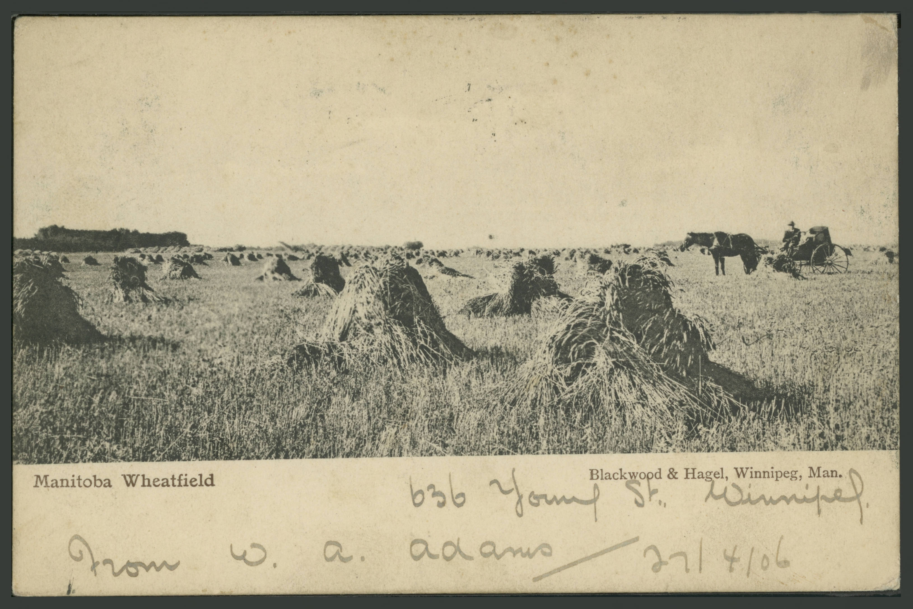
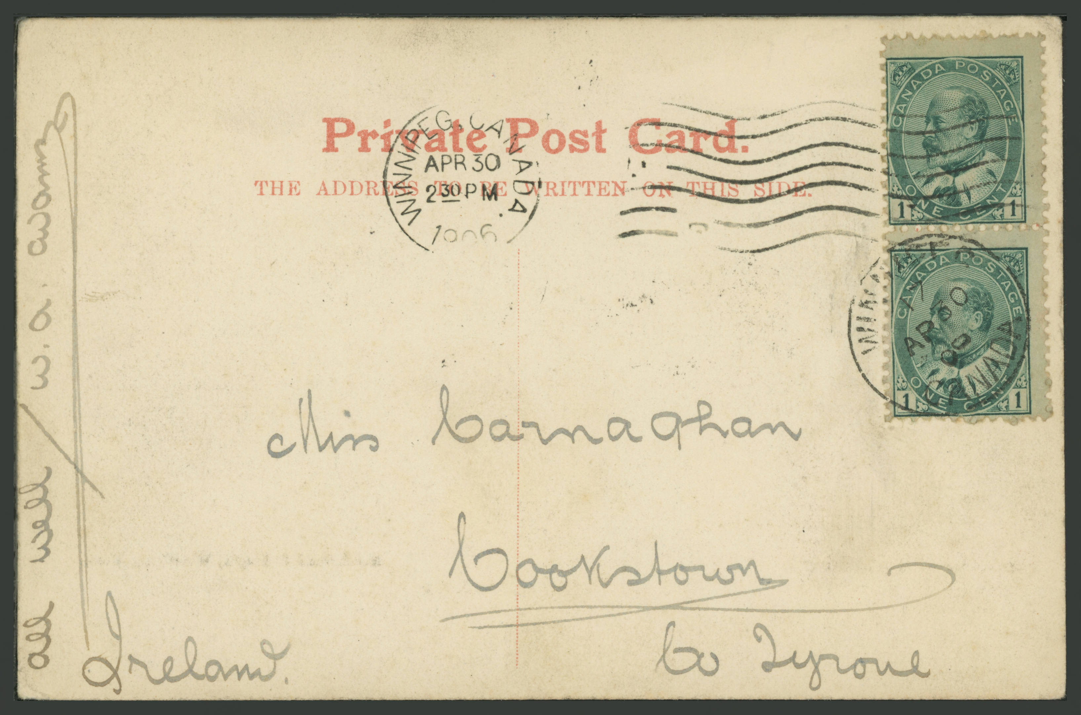
Sample Response
{ "Complete": "Yes", "Title": "Manitoba Wheatfield", "Description": "The image shows a wheat field with several stacks of harvested wheat. In the background, there is a horse-drawn carriage with a person seated.", "Street View": "", "Photographer": "", "Photography Studio": "Blackwood & Hagel, Winnipeg, Man.", "Sender": "W. A. Adams", "Recipient": "Miss Monaghan", "Recipient Address": "Cookstown, Co Tyrone, Ireland.", "Portrait Subject": "", "Annotation": "", "Message": "All well.", "Postal Data": "Postmarks: WINNIPEG CANADA APR 30 2:30 PM 1906; Postage: two 1 cent Canada stamps featuring Edward VII.", "Publisher": "", "Publisher Location": "", "Printer Location": "", "Serial Number": "", "Date Mailed": "1906-04-30", "Physical Description": "Approximately 140 mm x 90 mm", "Identifier": "B3A001", "Language": "English", "Historical Names": "", "Signs and Banners": "", "Subject": "Horses; Carriages & coaches; Wheat", "Geography": "Manitoba, Canada", "Subject Address": "", "Geographic Coordinates": "", "Date Range": "1906-1906", "All Search Years": "1906", "Type": "Still image", "Format": "Postcard", "Collector": "Martin Berman", "Usage Statement": "Public domain", "Digitial Publisher": "Winnipeg Public Library", "Binder": "B3A" }

Slide 23
Perfection? No. But not bad.
{ "Complete": "Yes", "Title": "Manitoba Wheatfield", "Description": "The image shows a wheat field with several stacks of harvested wheat. In the background, there is a horse-drawn carriage with a person seated.", "Street View": "", "Photographer": "", "Photography Studio": "Blackwood & Hagel, Winnipeg, Man.", "Sender": "W. A. Adams", "Recipient": "Miss Monaghan", "Recipient Address": "Cookstown, Co Tyrone, Ireland.", "Portrait Subject": "", "Annotation": "", "Message": "All well.", "Postal Data": "Postmarks: WINNIPEG CANADA APR 30 2:30 PM 1906; Postage: two 1 cent Canada stamps featuring Edward VII.", "Publisher": "", "Publisher Location": "", "Printer Location": "", "Serial Number": "", "Date Mailed": "1906-04-30", "Physical Description": "Approximately 140 mm x 90 mm", "Identifier": "B3A001", "Language": "English", "Historical Names": "", "Signs and Banners": "", "Subject": "Horses; Carriages & coaches; Wheat", "Geography": "Manitoba, Canada", "Subject Address": "", "Geographic Coordinates": "", "Date Range": "1906-1906", "All Search Years": "1906", "Type": "Still image", "Format": "Postcard", "Collector": "Martin Berman", "Usage Statement": "Public domain", "Digitial Publisher": "Winnipeg Public Library", "Binder": "B3A" }

Slide 24
Perfection? No. But not bad.
{ "Complete": "Yes", "Title": "Manitoba Wheatfield", "Description": "The image shows a wheat field with several stacks of harvested wheat. In the background, there is a horse-drawn carriage with a person seated.", "Street View": "", "Photographer": "", "Photography Studio": "Blackwood & Hagel, Winnipeg, Man.", "Sender": "W. A. Adams", "Recipient": "Miss Monaghan", "Recipient Address": "Cookstown, Co Tyrone, Ireland.", "Portrait Subject": "", "Annotation": "", "Message": "All well.", "Postal Data": "Postmarks: WINNIPEG CANADA APR 30 2:30 PM 1906; Postage: two 1 cent Canada stamps featuring Edward VII.", "Publisher": "", "Publisher Location": "", "Printer Location": "", "Serial Number": "", "Date Mailed": "1906-04-30", "Physical Description": "Approximately 140 mm x 90 mm", "Identifier": "B3A001", "Language": "English", "Historical Names": "", "Signs and Banners": "", "Subject": "Horses; Carriages & coaches; Wheat", "Geography": "Manitoba, Canada", "Subject Address": "", "Geographic Coordinates": "", "Date Range": "1906-1906", "All Search Years": "1906", "Type": "Still image", "Format": "Postcard", "Collector": "Martin Berman", "Usage Statement": "Public domain", "Digitial Publisher": "Winnipeg Public Library", "Binder": "B3A" }
AI saw "Monaghan"
Actually "Carnaghan"
(I think)
AI correctly understood that the photo could be no later than 1906, but wrongly stated that it couldn't be older
AI recognised this as an M. I didn't.

Slide 25
After Response
Convert from JSON (JavaScript Object Notation) format to TSV (Tab Separated Values).
Run our digital repository’s ingest process
Vet and correct results*
Approve and publish cards
* This is where the time goes

Slide 26
Automating the Process
For each card under a given folder on disk a python script was written to:
load a front/back image pair from a directory structure
pre-process them
send them to OpenAI with the prompt
save the JSON response to the directory structure for the card
Another script was written to convert the JSON response into a TSV file that our DRM software understands for import.
https://github.com/pr3sidentspence/CONTENTdm-OpenAI
Notes:
If this seems intimidating, know that some of it was just copied from elsewhere and some of it was... [next slide]

Slide 27
How Many? How Quickly?
OpenAI can do a card in seconds
Still needs human vetting!
New workflow estimate*:
Can do work that used to take a year in about a month
Roughly 10x improvement in speed
* hard to say for sure, difficult to make a direct comparison

Slide 28
What about Quality?
Not as good as our human cataloguer
But… good enough
(Especially as compared to the rather sparse descriptions other repositories provide. Although, others are beginning to make use of handwriting recognition)
All postcards described with the aid of AI have the following added to the notes field when published:
OpenAI GPT-4o used to generate some of the information in this record. Use with caution. Report errors to eref@wpl.libanswers.ca .
Notes:
Say: She says she’s impressed now (she wasn’t with previous tries) and wished she had the time to go into the depth that the AI does. I don’t see it, I think her work was better.

Slide 29
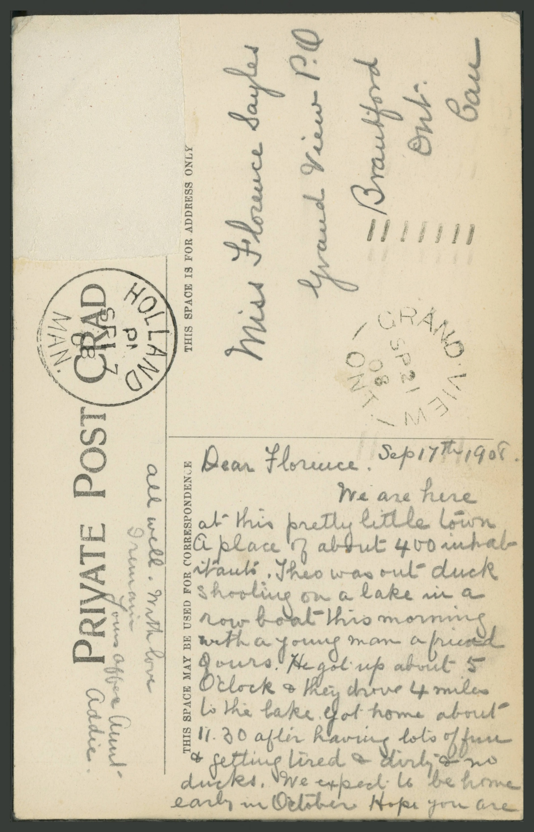
Funny Problems
Once the OpenAI’s transcription gets something wrong, the rest is usually a hallucination, and it rarely recovers.
Actual message: Sep 17th 1908, Dear Florence, We are here at this pretty little town A place of about 400 inhabitants. Theo was out duck shooting on a lake in a row boat this morning with a young man a friend of ours. He got up about 5 O'clock & they drove 4 miles to the lake. Got home about 11:30 after having lots of fun & getting tired and dirty & no ducks. We expect to be home early in October. Hope you are all well. With love, I remain yours [?] Aunt Addie.
Voice source: https://speechactors.com

Slide 30
Funny Problems
Once the OpenAI’s transcription gets something wrong, the rest is usually a hallucination, and it rarely recovers.
OpenAI’s transcription: Dear Florence, Sept 17/06. We are at this fair. A little impulse made us stop and go grub fishing after 4 o'clock lunch. Sleeping in a real duck about 15 miles in the lake. Harry got a young mom. A young looking slug of her lost her about 5. The fake of this show 4 miles long and 11.30 at night plenty of fun about 4 or 5 on reach to go on. See you are easy figuring out. Yours, Harry
Voice source: https://speechactors.com

Slide 31
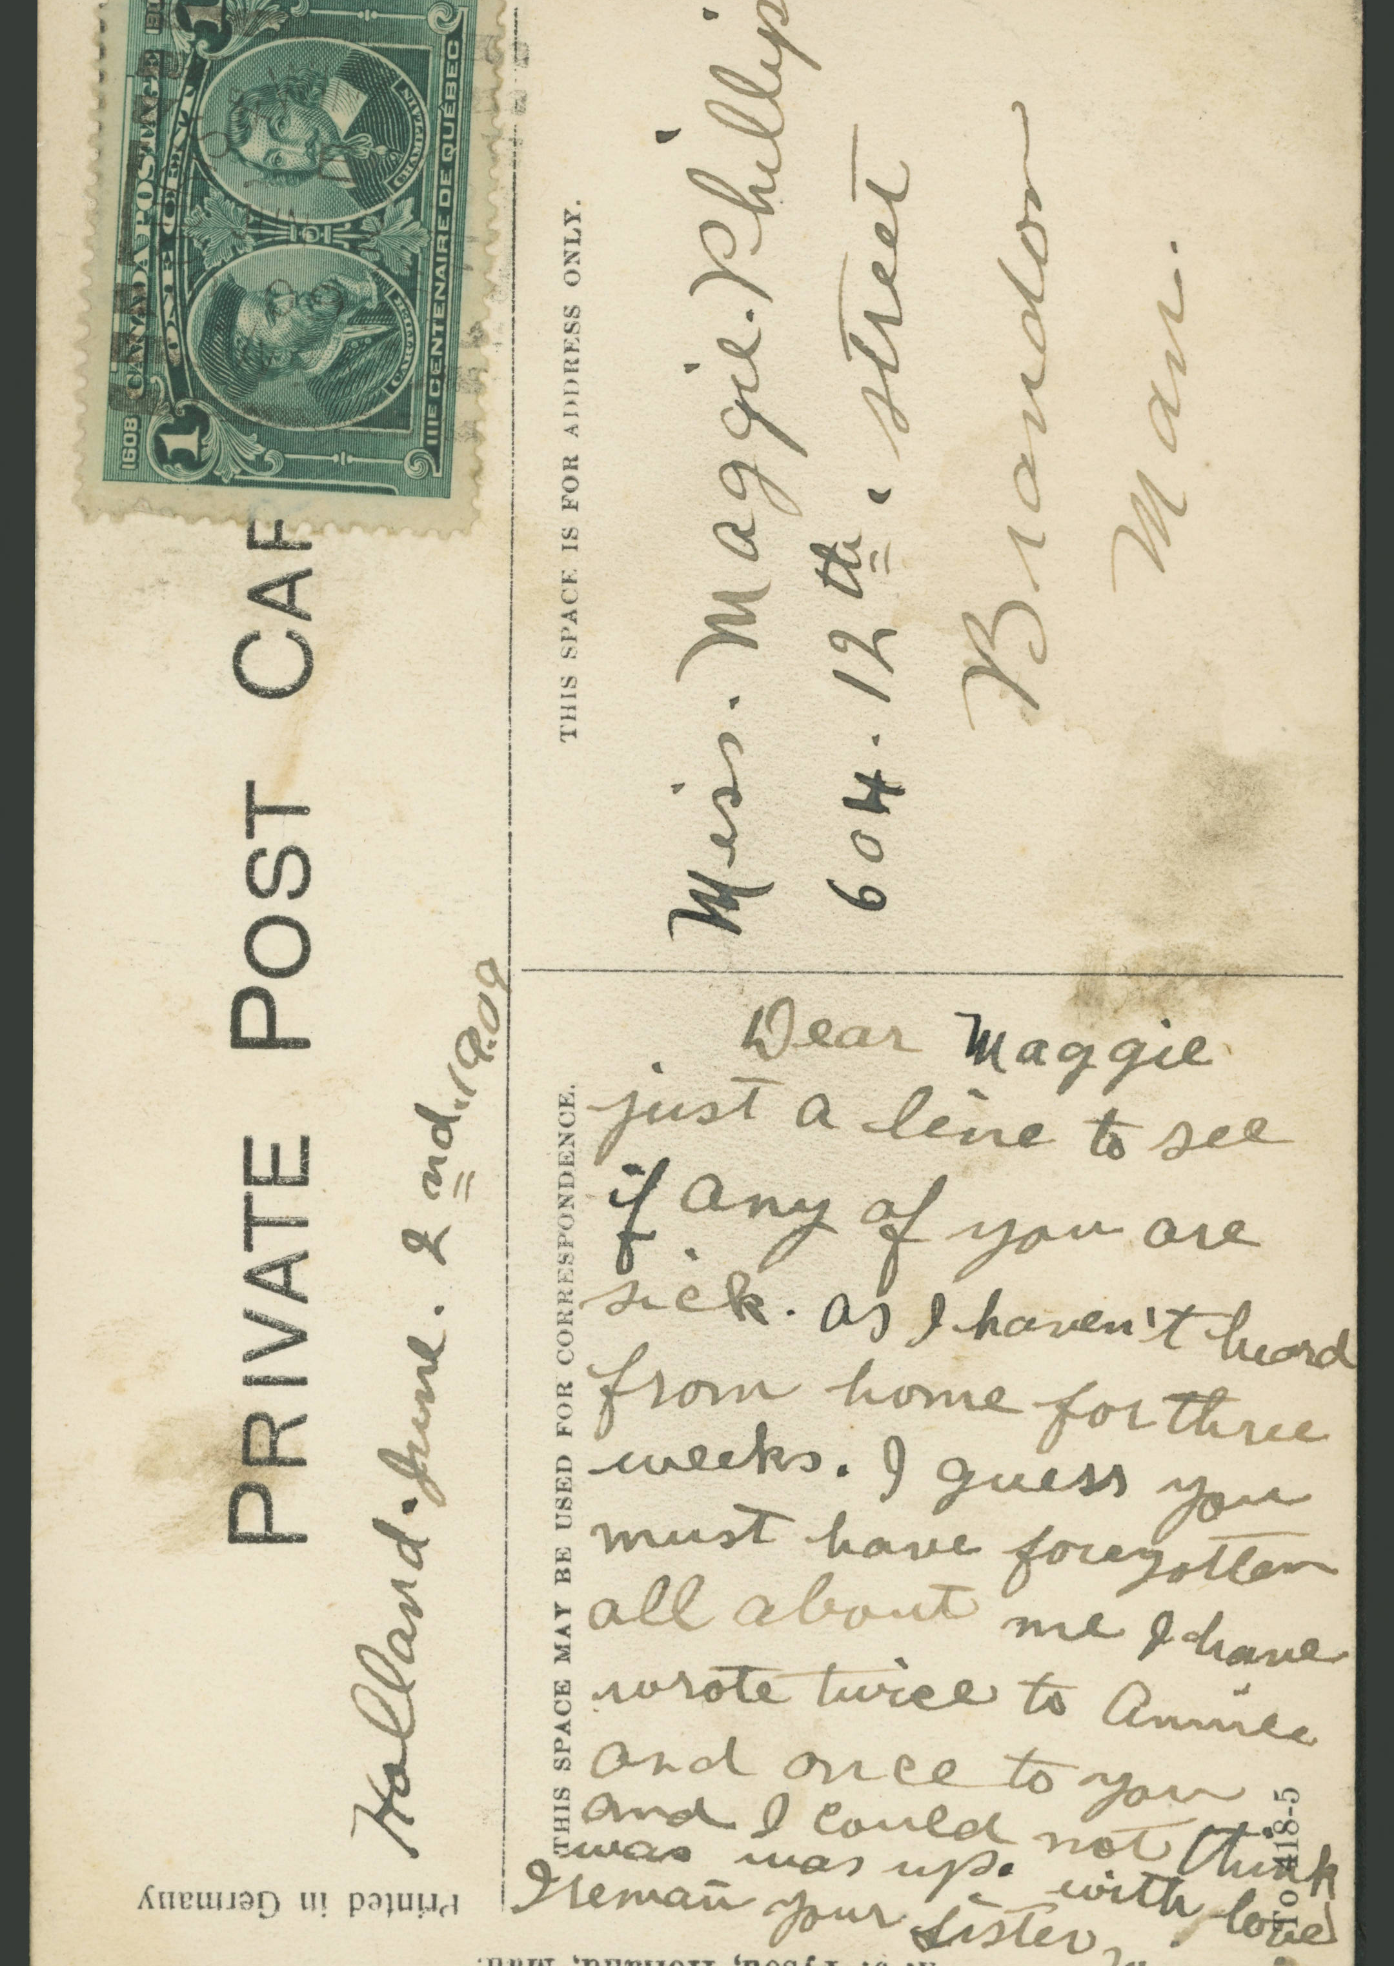
Funny Problems
Once the OpenAI’s transcription gets something wrong, the rest is usually a hallucination, and it rarely recovers.
Actual message: Holland. June 2nd, 1909 Dear Maggie, Just a line to see if any of you are sick as I haven't heard from home for three weeks. I guess you must have forgotten all about me I have wrote twice to Annie and once to you and I could not think was [sic] was up. with love I remain your Sister Winnie. write soon
Voice source: https://speechactors.com

Slide 32
Funny Problems
Once the OpenAI’s transcription gets something wrong, the rest is usually a hallucination, and it rarely recovers.
Actual message: Holland. June 2nd, 1909 Dear Maggie, Just a line to see if any of you are sick of Holland. Thanks! I’m home for three weeks. I guess I must forget you all about me. I guess you are dead or lost to me!
Voice source: https://speechactors.com

Slide 33
Not-so-funny Problems
Despite prompting it to learn-from or refer-to existing PastForward content, it does not (may have to upload it in appropriate format)
It really struggles with the dates on postmarks
It rarely gets the date ranges (the start dates) correct
Will sometimes try to count things (e.g., "Six men on farm machinery") and counts wrong (there were at least 20 people)

Slide 34
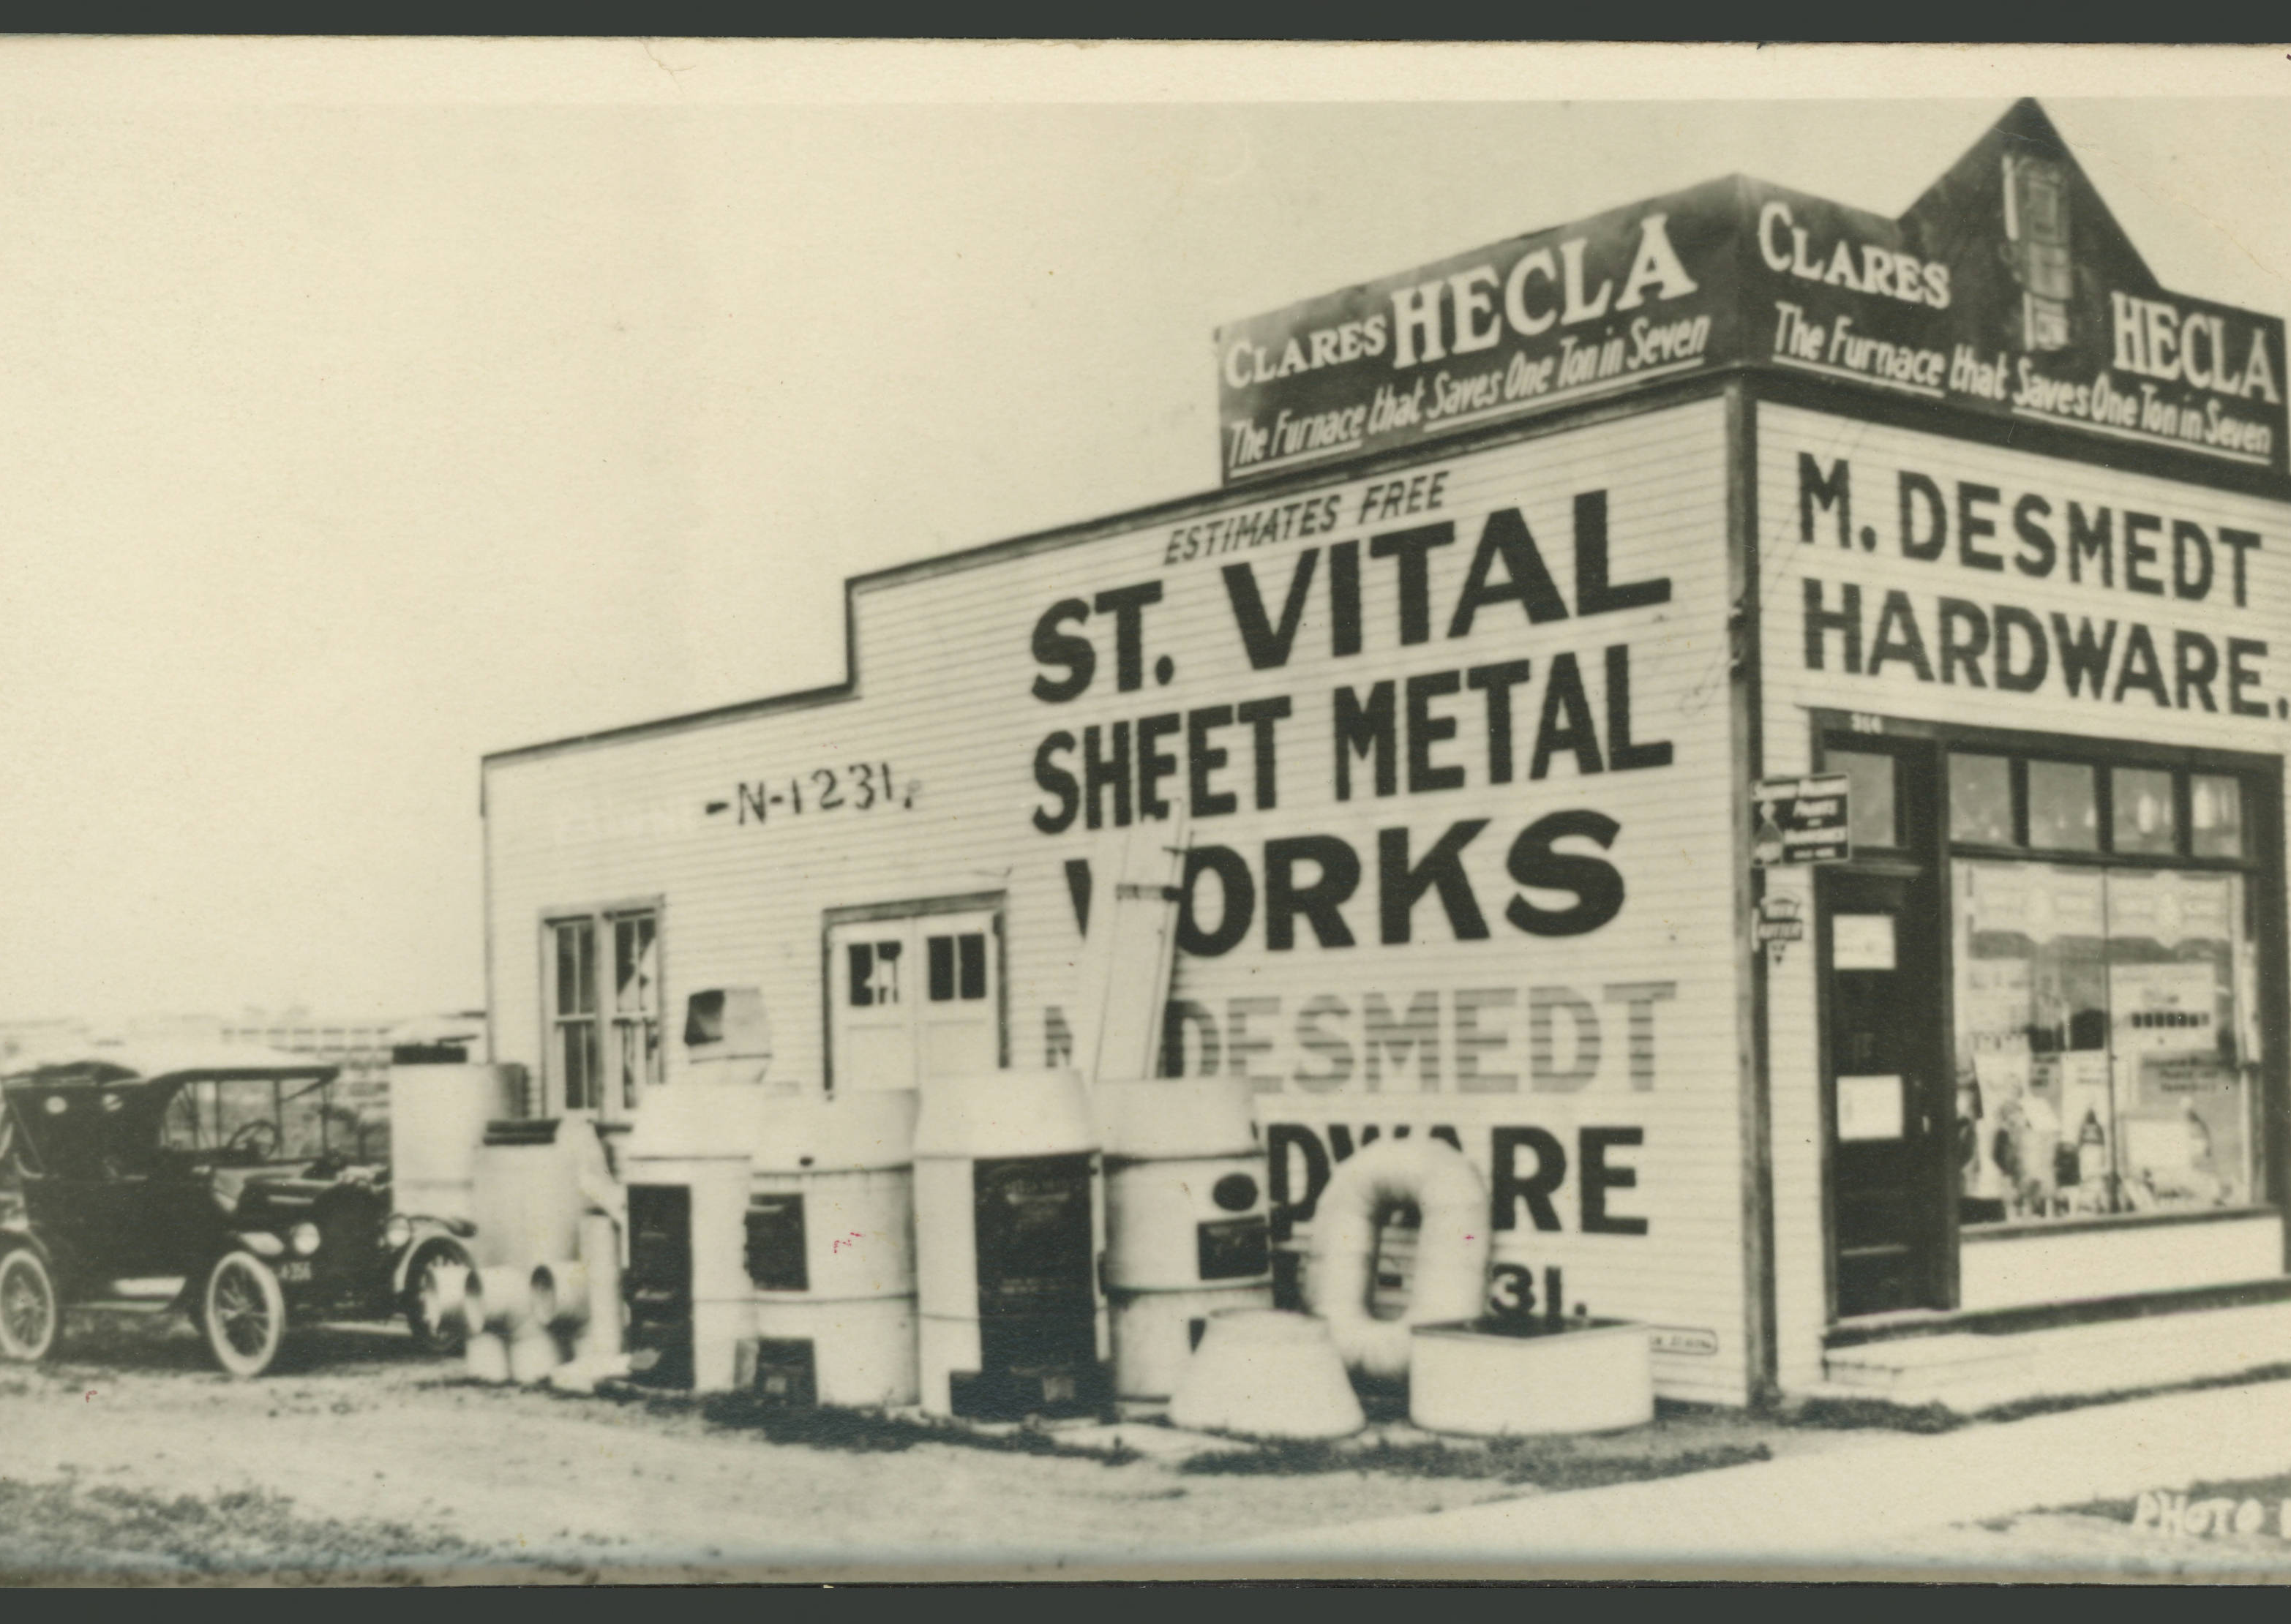
Surprising not-so-problems
Under “Signs” OpenAI listed “PHONE”
“PHONE?”
I don’t see “PHONE” do you?
How about now?

Slide 35
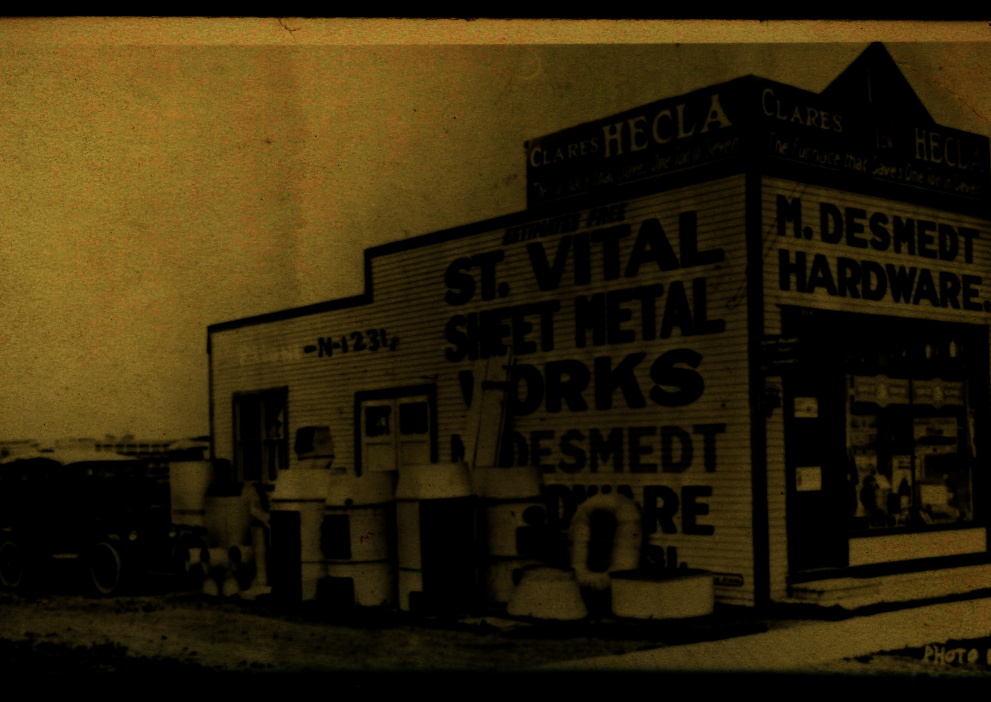
Surprising not-so-problems
Under “Signs” OpenAI listed “PHONE”
“PHONE?”
I don’t see “PHONE” do you?
How about now?
Oh!

Slide 36
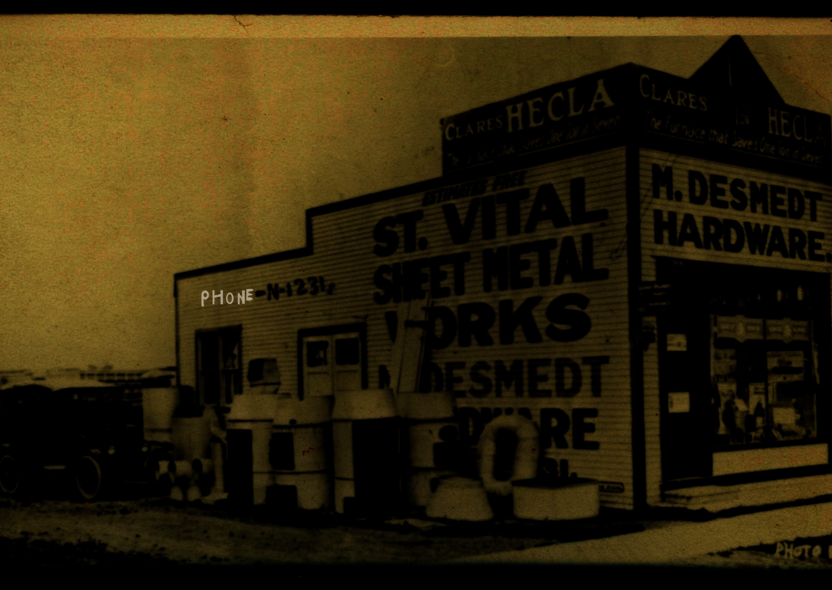
Surprising not-so-problems
Under “Signs” OpenAI listed “PHONE”
“PHONE?”
I don’t see “PHONE” do you?
How about now?
Oh!

Slide 37
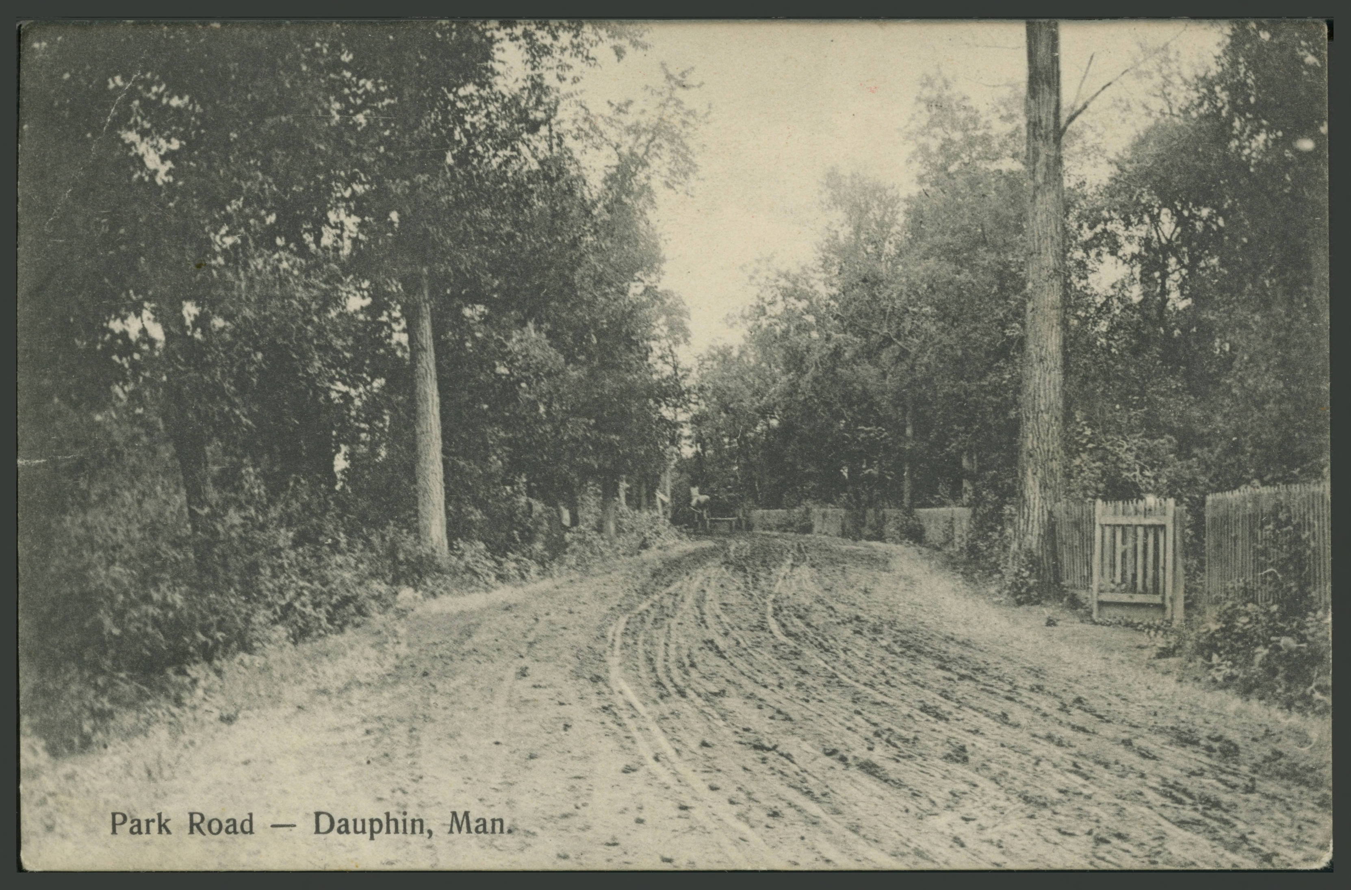
Surprising not-so-problems
OpenAI Description: “The image shows a dirt road lined with tall trees and wooden fences on both sides. There is a horse-drawn carriage in the distance.”

Slide 38

Surprising not-so-problems
OpenAI Description: “The image shows a dirt road lined with tall trees and wooden fences on both sides. There is a horse-drawn carriage in the distance.”

Slide 39
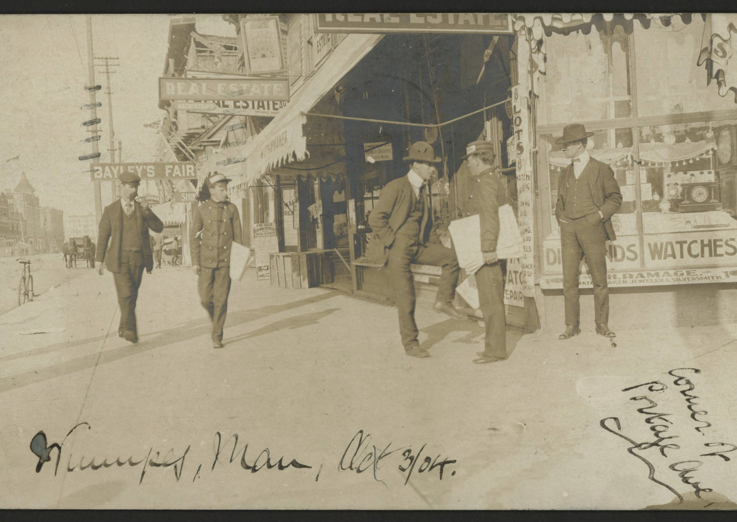
Surprising not-so-problems
AI correctly inferred this was DIAMONDS

Slide 40
In Summary
AI item descriptions are now possible
Relatively easy to set up
Inexpensive (about 15¢ (CAD) per postcard)
Not good enough to go unvetted, staff still needed
So far, nothing offensive produced
Sometimes spots things a human might not

